Slide 1

Soccer is Big Data
By the Diamond Dogs
Kyle Burks
Simone De Oliveira Allen
Matt Swanwick
Caleb Wolf
This Photo by Unknown Author is licensed under CC BY-NC

Slide 2

Our Goal
NOTE:
To change images on this slide, select a picture and delete it. Then click the Insert Picture icon
in the placeholder to insert your own image.
To create an easy-to-use interface that houses current stats from soccer leagues around the world

Slide 3

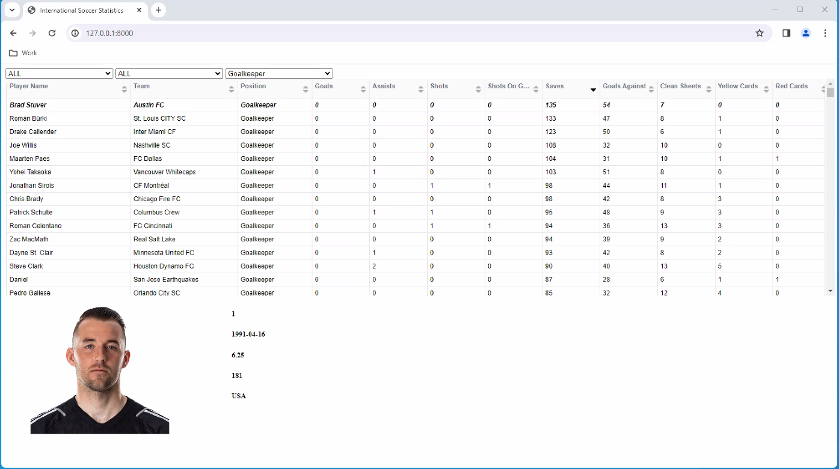
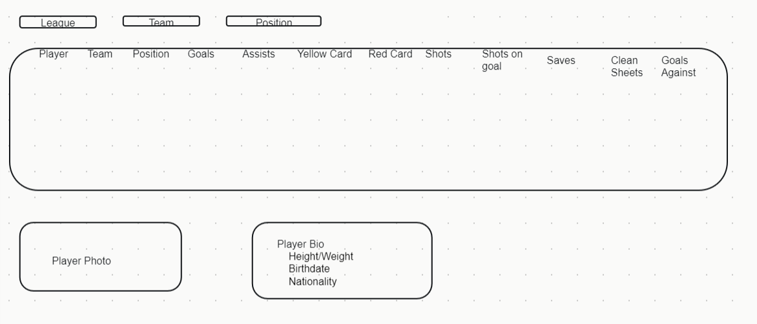
How it started
How it’s going

Slide 4
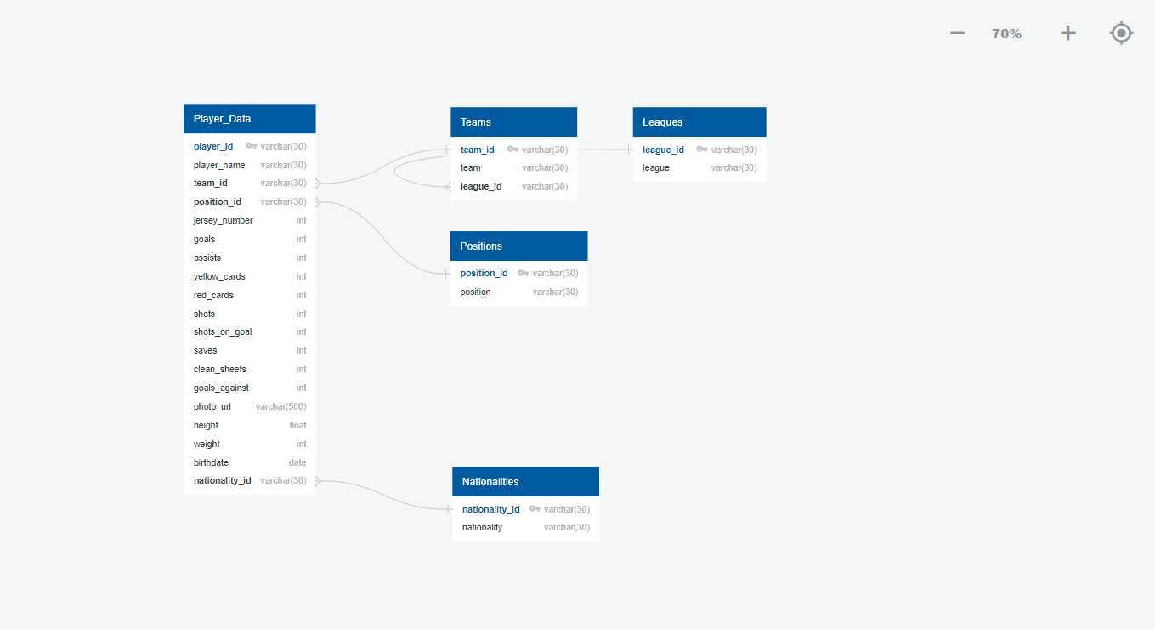
Database Layout

